Slide 1
Data Mining Cornerstone Project(Review:3) ATTENDANCE ANALYSIS SYSTEM
DEPARTMENT OF DATA SCIENCE

Slide 2
V. Yamini Sri – Team Leader Project planning & coordination Dataset understanding and integration
T. Kalpana – Data Preprocessing Data cleaning Handling missing values
Y. Yasaswini – Data Analysis Attendance and performance analysis Result observation
K. Sushma – Documentation & Presentation PPT preparation Final report and presentation
Presented by -TEAM MEMBERS

Slide 3
Problem Statement
Educational institutions regularly collect attendance data, but it is mostly used only for maintaining records. The data is not properly analyzed to understand how attendance affects student performance. The relationship between attendance and academic results is not clearly studied. As a result, weak students are often identified only after they score low in exams. Therefore, there is a need for a system that analyzes attendance data to identify at-risk students at an early stage.

Slide 4
INTRODUCTION
Attendance plays an important role in student academic performance.
Regular attendance helps students understand concepts better and score higher marks.
This project analyzes: 🔲 Attendance Percentage 🔲 Internal Marks
🔲 Final Exam Marks 🔲 CGPA
By analyzing these factors, students' performance levels can be understood clearly.
Based on the analysis, students are classified into:
▫️Good ▫️Average▫️ Poor
This helps in identifying weak students early and providing timely support.

Slide 5
Tools & Methodologies Used
Tool :
WEKA (Waikato Environment for Knowledge Analysis) – used to perform data mining and machine learning tasks.
Methodologies:
⚪Data Preprocessing
The dataset was cleaned by removing duplicate and unnecessary attributes . This helps improve the quality of the data before applying algorithms.
⚪ Classification
The J48 Decision Tree algorithm was used to classify students into Good, Average, and Poor categories based on their performance.
⚪ Clustering
The Simple K-Means algorithm was used to group students with similar attendance and marks.
⚪ Visualization
Graphs such as scatter plots were used to clearly observe the relationship between attendance and CGPA.
⚪ Association Rule Mining
Identifies relationships between attendance, marks, and performance using support and confidence. Generates meaningful rules using algorithms like Apriori, FP-Growth, and ECLAT to detect patterns such as low attendance leading to poor performance.
📈

Slide 6
Dataset Attributes
The dataset contains information related to student attendance and academic performance.
Attributes included:
Student ID
Class
Section
Subject
Total Classes
Classes Attended
Attendance Percentage
Internal Marks
Final Exam Marks
CGPA
Performance Status
By using these attributes, we can analyze the relationship between attendance and academic results and identify weak students.

Slide 7
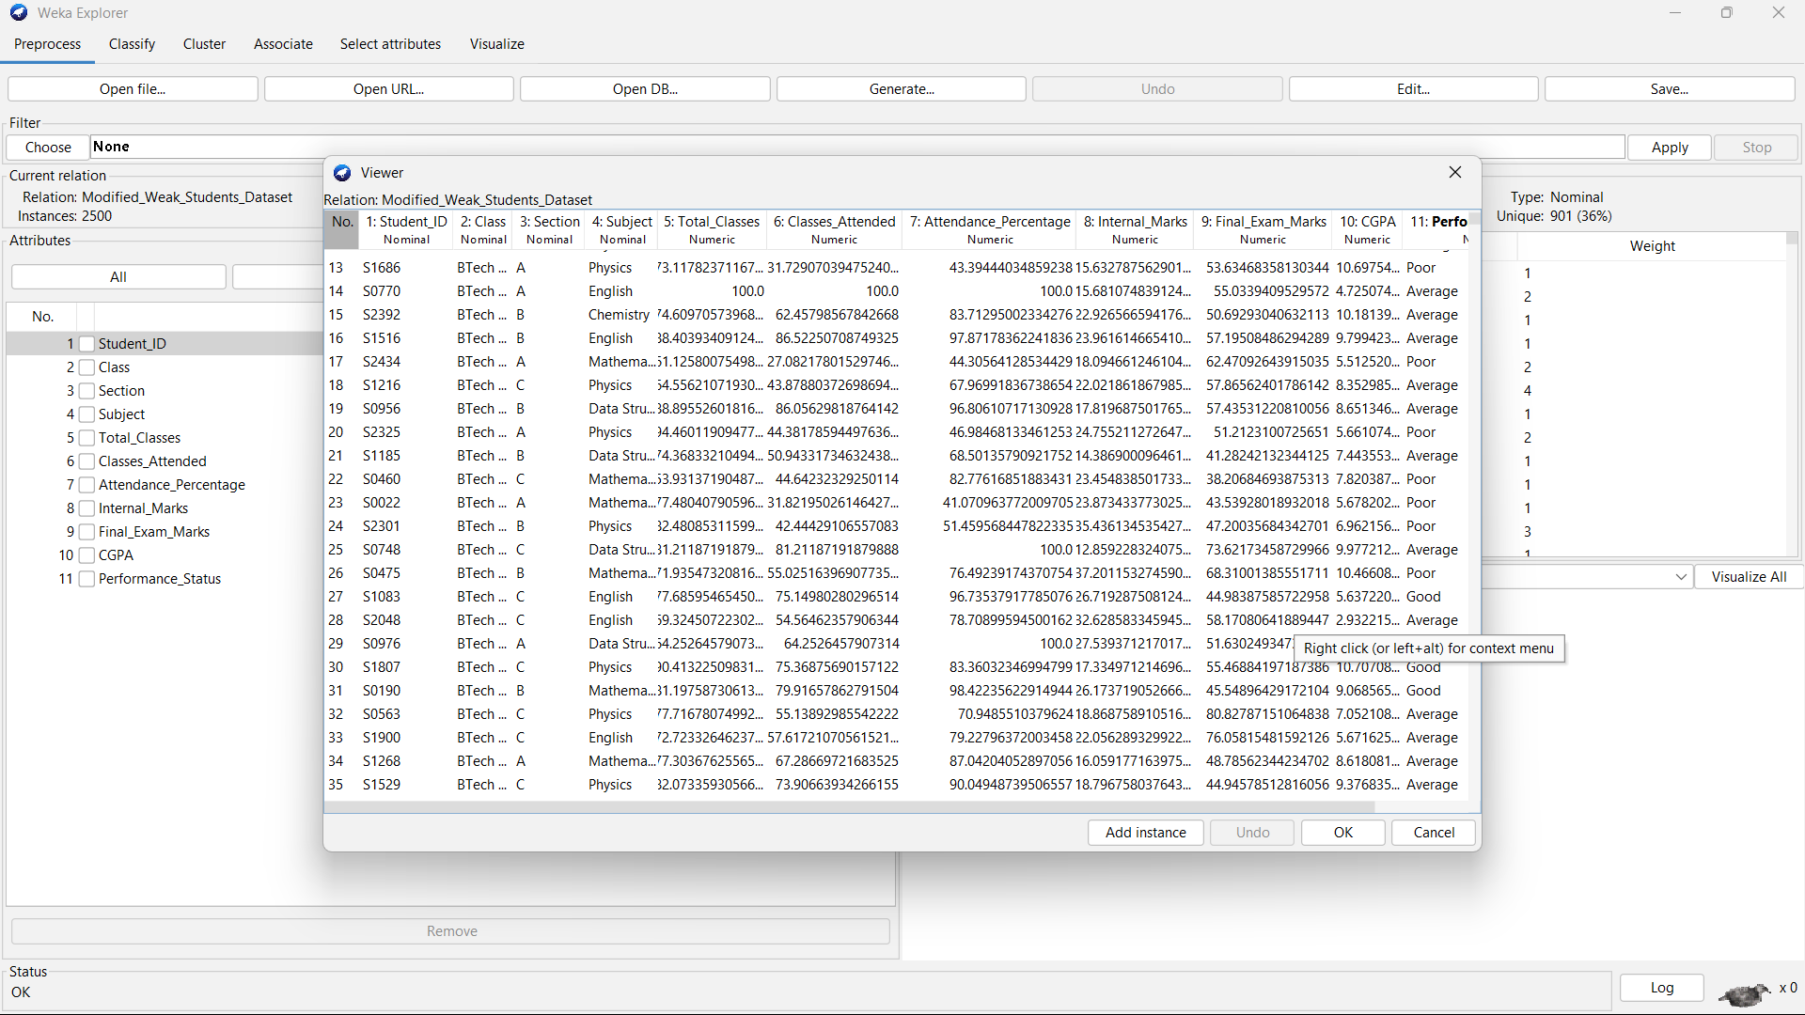
Dataset Description
📑
Source: Kaggle
Dataset Information:
Total Records(Before Cleaning): 2505
Duplicate Records
Removed: 5
Final Records Used:
2500
Total Attributes: 11
Format: CSV

Slide 8
Preprocessing Steps
Data preprocessing is the process of cleaning and preparing the dataset before applying machine learning algorithms.
It helps improve the quality of the dataset so that the analysis becomes more accurate and reliable.
In this project, preprocessing steps include duplicate removal, irrelevant attribute removal, missing value check, normalization, and standardization.

Slide 9
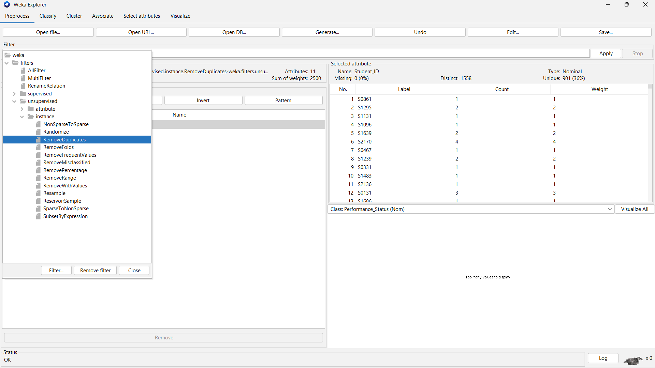
Duplicate Removal
The dataset initially contained 2505 records. Some records were repeated, meaning the same data appeared more than once .
These duplicate records can affect the analysis and may lead to incorrect results .
To avoid this problem, 5 duplicate records were removed , resulting in 2500 unique records .
Removing duplicate data helps ensure that each record represents a unique student and improves the reliability of the dataset.

Slide 10
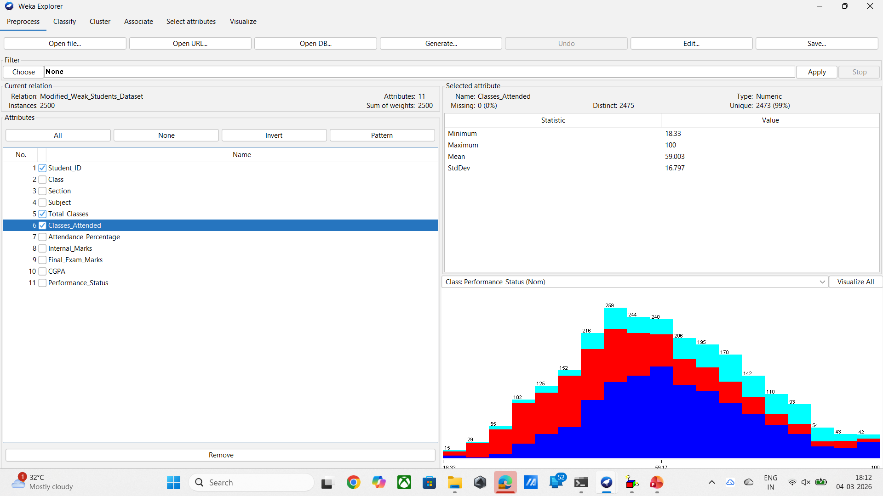
Irrelevant Attribute Removal:
Some attributes in the dataset were not useful for predicting student performance .
Attributes such as Student ID, Total Classes, and Classes Attended were removed using the Remove Filter in WEKA .
These attributes were removed because they do not contribute to the prediction process .
Removing unnecessary attributes helps reduce data complexity and improves the efficiency of the analysis.

Slide 11
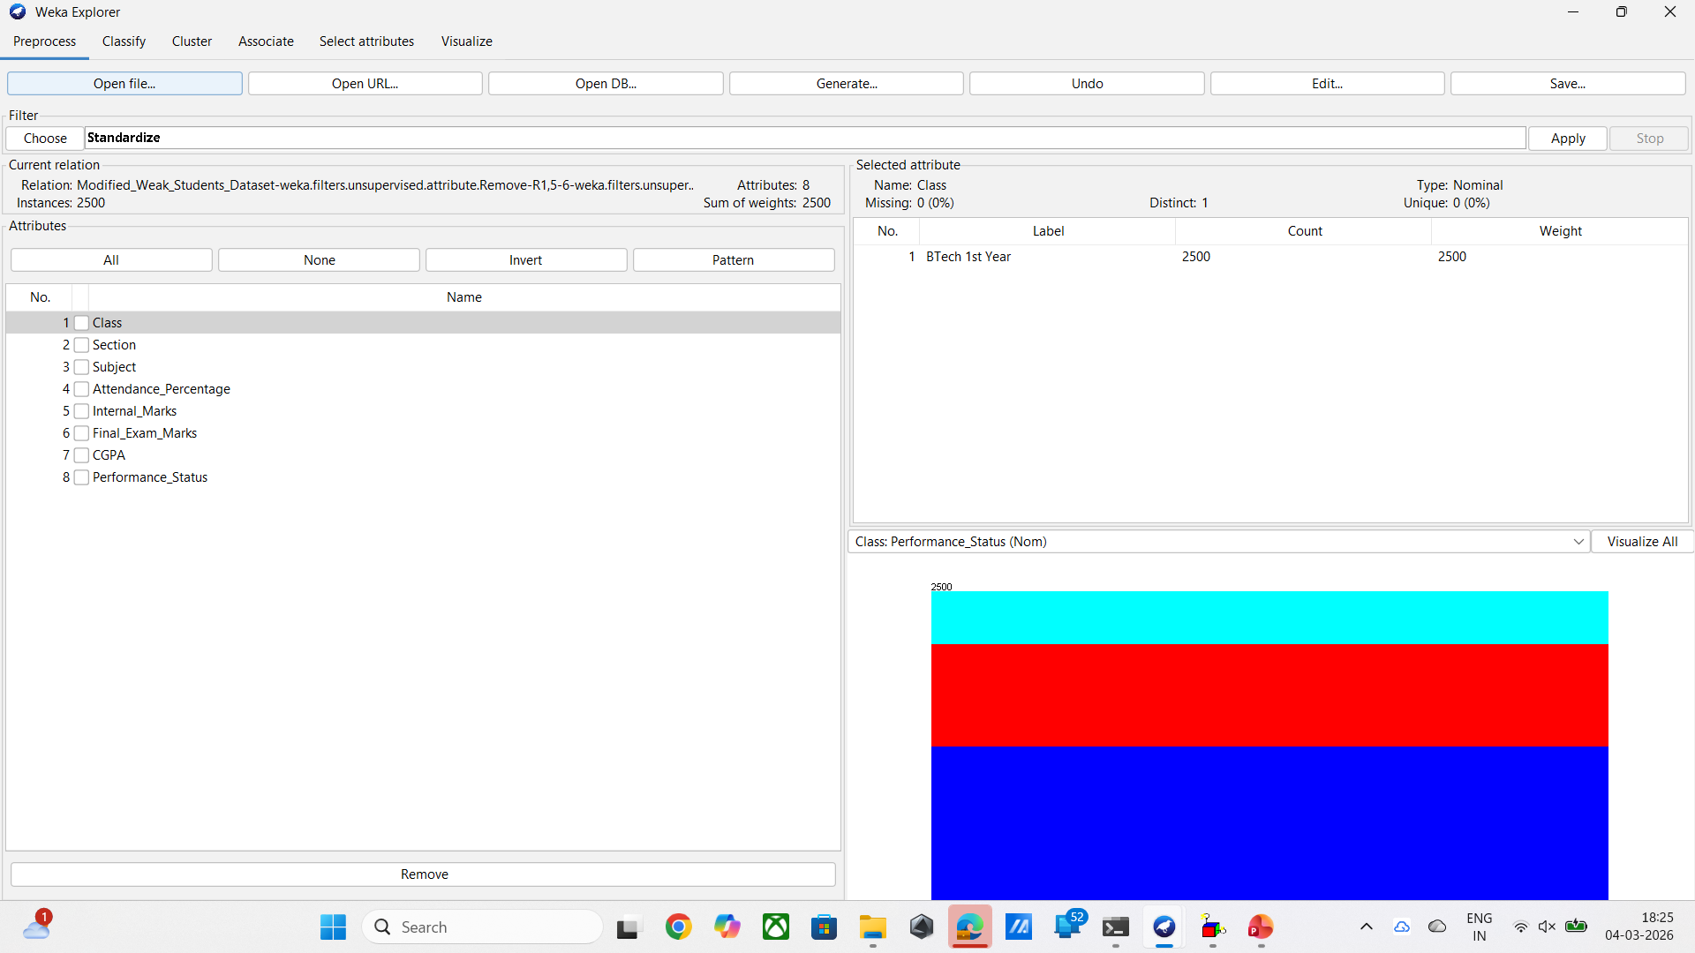
Missing Value Check:
The dataset was checked to see if any attributes contained missing values .
Missing values can create problems during analysis because algorithms may not work correctly when data is incomplete .
After checking the dataset, no missing values were found in any attribute .
Since the dataset was complete, no additional steps were required for handling missing data.

Slide 12
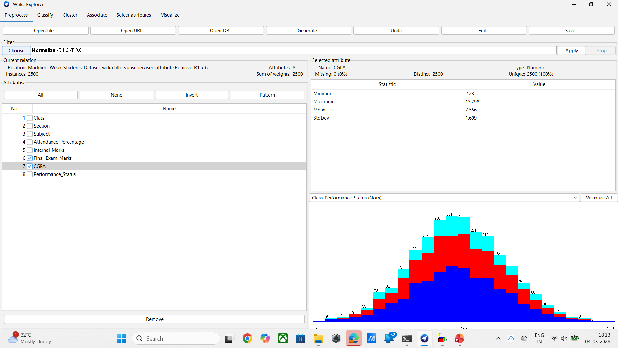
Normalization:
Normalization was applied to convert numeric values into a common range between 0 and 1.
In the dataset, different attributes such as attendance percentage, marks, and CGPA have different value ranges.
If these values are used directly, attributes with larger values may dominate the analysis .
By converting all values into the same range, normalization helps the algorithm treat all attributes equally and improves the quality of the analysis.

Slide 13

Standardization :
Standardization was applied to transform the data so that it has a mean value of 0 and a standard deviation of 1.
This transformation helps bring the data to a balanced distribution .
Standardization is useful for machine learning algorithms because it reduces the effect of large variations in the data and improves model performance .
By applying standardization, the dataset becomes more consistent for analysis.

Slide 14
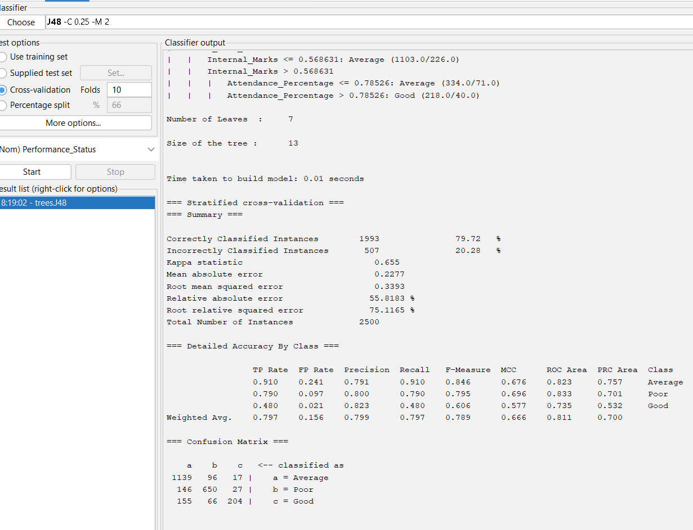
Classification :
Classification : Classification predicts categories of data . In this project, student performance is classified as Average, Poor, or Good using Internal Marks and Attendance.
Confusion Matrix:
A confusion matrix evaluates a classification model by comparing actual values with predicted values.
TP: Correctly predicted instances
FP: Incorrectly predicted as that class
FN: Actual instances predicted as another class
TN: Correctly predicted as not belonging to that class
Result from Analysis
Correct predictions: 1139 Average, 650 Poor, 204 Good
Model Accuracy: 79.72%
White

Slide 15
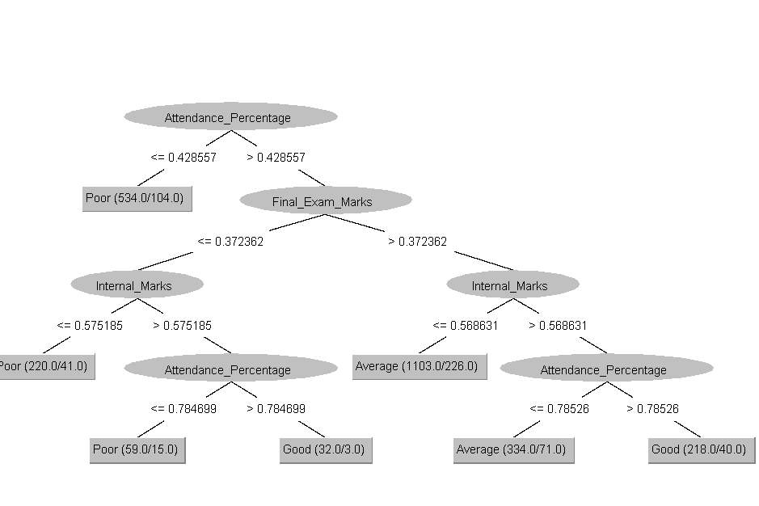
Student Performance Classification using Decision Tree:

Slide 16
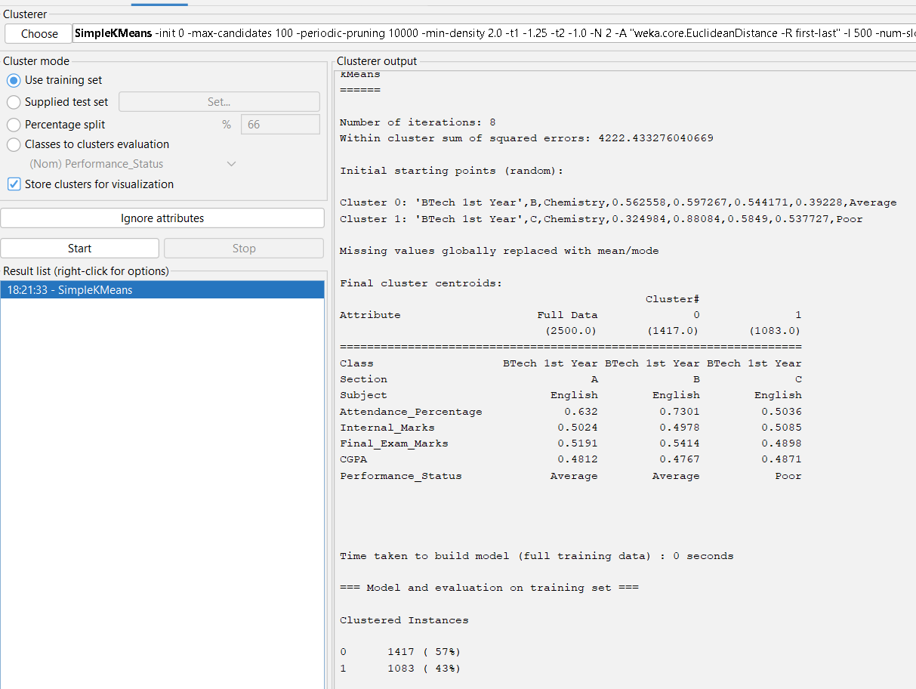
Clustering (Simple K-Means) :
Clustering is a data mining technique used to group similar data objects together and it is an unsupervised learning method. Clustering is performed to identify patterns and group students based on their academic performance .
◽Total Instances: 2500
◽ Number of Clusters: 2
◽ Iterations: 8
◽ Cluster 0: 1417 students (57%) – Average performance
◽ Cluster 1: 1083 students (43%) – Poor performance
◽ Attributes used: Attendance, Internal Marks, Final Exam Marks, CGPA

Slide 17
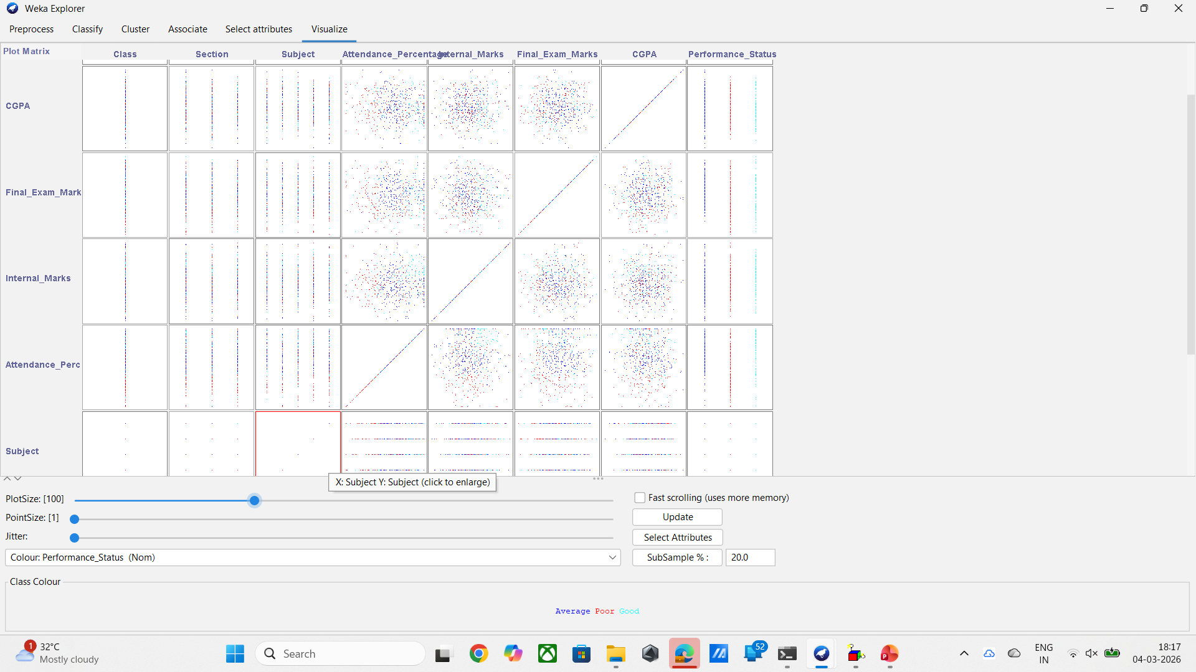
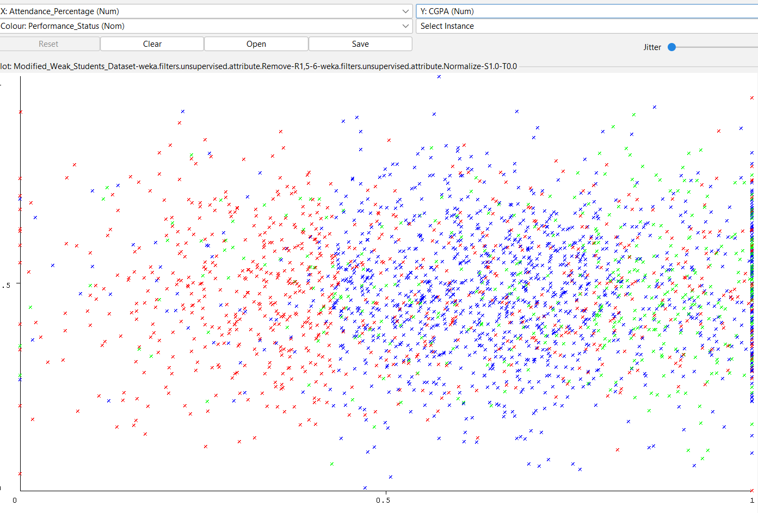
Visualization Analysis
Visualization was performed using a scatter plot in the tool WEKA .
The scatter plot was used to observe the relationship between Attendance Percentage and CGPA .
From the graph, it can be seen that students with higher attendance tend to have higher CGPA, while students with lower attendance tend to have lower CGPA .
Visualization helps to clearly understand patterns and relationships in the dataset before applying machine learning algorithms.

Slide 18
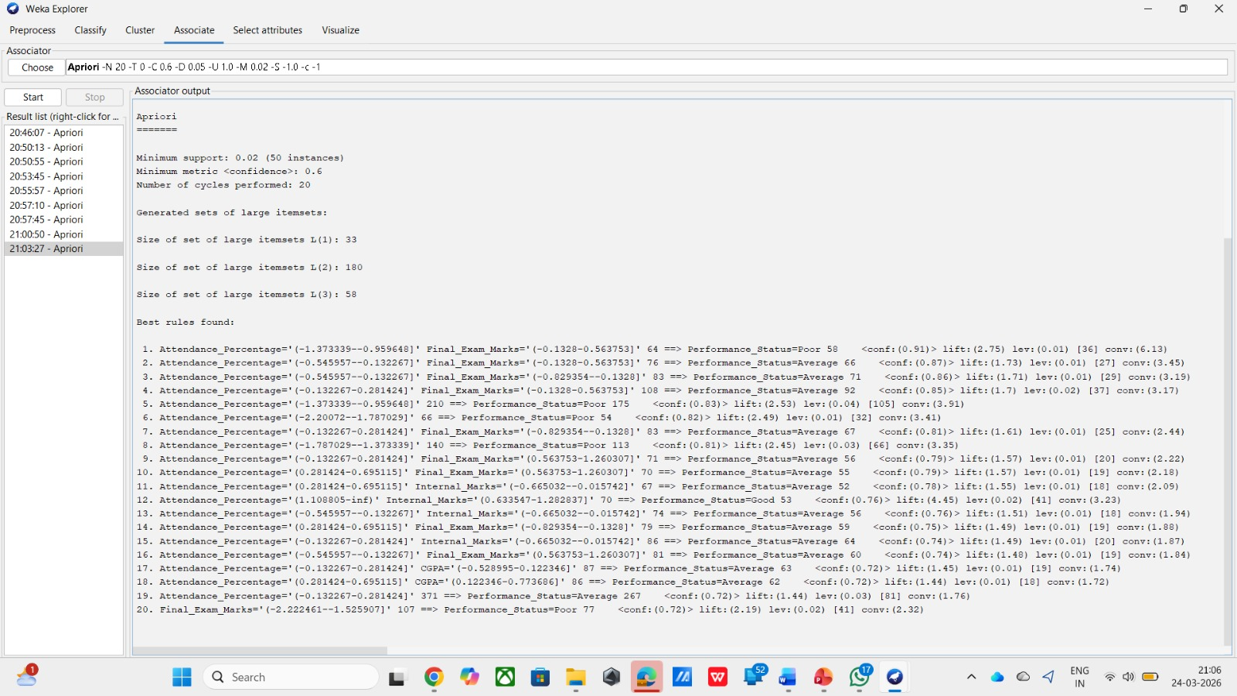
Association Rule Mining
Association Rule Mining (Apriori) is a data mining technique used to find relationships between
different attributes in a dataset. It helps to discover patterns that show how student performance is influenced by factors like attendance and marks.
◽ Total Instances: 2500
◽ Number of Rules Generated: 20
◽ Minimum Support: 0.02
◽ Minimum Confidence: 0.6
◽ Number of Cycles Performed: 20
◽ Frequent Itemsets:
• L(1): 33
• L(2): 180
• L(3): 58
◽ Attributes Used: Attendance, Internal Marks,
Final Exam Marks, CGPA, Performance Status
◽ Key Findings:
• Low attendance is strongly associated with poor performance
• Medium attendance and marks lead to average performance
• High attendance and internal marks lead to good performance

Slide 19
Objectives ◾Analyze attendance data ◾ Study attendance-performance relationship ◾ Classify students into Good, Average, Poor ◾ Apply clustering to group similar students ◾ Generate academic improvement insights
Scope of the Project:
◾ Can be implemented in: Schools
Colleges
◾ Benefits: Early identification of
weak students
◾ Supports faculty decision-making
Future Enhancements:
◾ Add assignment marks
◾Behavioral data
◾ Real-time dashboards
◾ Advanced ML algorithms

Slide 20
Conclusion
Successfully applied data mining techniques J48 achieved 79.72% accuracy
Strong relationship between attendance & performance

Slide 21
THANK YOU

